Slide 1

Pointers, DMA and Strucutres
By group 7
Anoop Gupta, Samarth Devdiga, Swaraj Wattamwar, Sahil Shah, Harsh Mishra

Slide 2
Understanding Pointer
In C++, a pointer is a variable that holds the memory address of another variable. This allows for indirect access and manipulation of the data stored at that location. Instead of holding a value directly, it "points" to a memory location.
Syntax: dataType *pointerName; Example: int *ptr; (Here, ptr is a pointer variable that can store the address of an integer.)
Initialization: Before using a pointer, it must be initialized to point to a valid memory address. This can be done using the address-of operator (&). Example: int num = 10; int *ptr = &num; (ptr now holds the address of num)
Dereferencing: To access the value stored at the memory location pointed to by a pointer, the dereference operator (*) is used. Example: cout << *ptr; (This will output the value of num, which is 10)

Slide 3
Understanding Pointer Syntax
Declaration
Referencing
Dereferencing
Pointers store memory addresses. Use * to declare a pointer variable.
Use & to get a variable's address. Assign to a pointer.
Access the value at the pointer's address. Use * to dereference.
Example:
Example:
Example:
int *ptr;
int num = 10; ptr = #
int value = *ptr;
ptr holds the address of an integer.
ptr now points to num.
value is now 10 (the value of num).

Slide 4
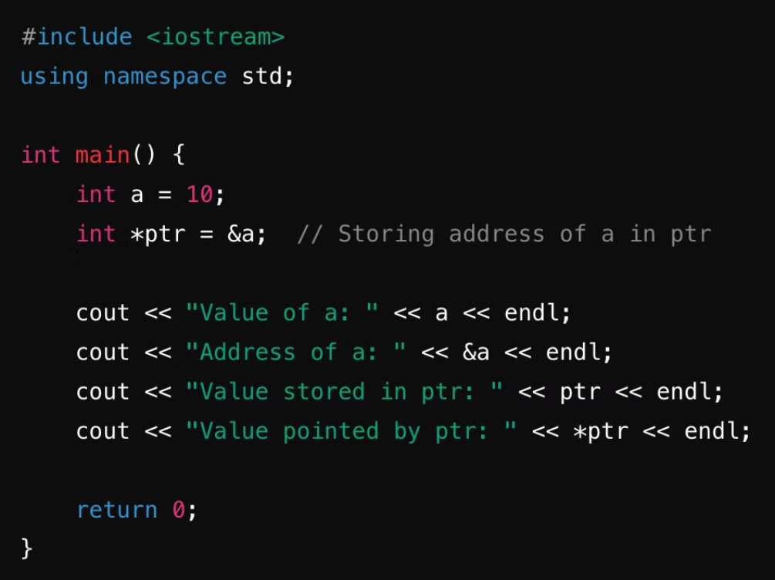
Example for syntax

Slide 5




Exploring Pointer Arithmetic
Increment (ptr++)
Advances to the next memory location (next element in array).
ptr++
Increases pointer address by data type size.
Decrement (ptr--)
Moves to the previous memory location (reverse array traversal).
ptr--
Decreases pointer address by data type size.
Addition (ptr + n) / Subtraction (ptr - n)
Moves pointer by n positions (access elements at offset).
ptr + n and ptr - n
Moves pointer n elements forward/backward. For random access.

Slide 6
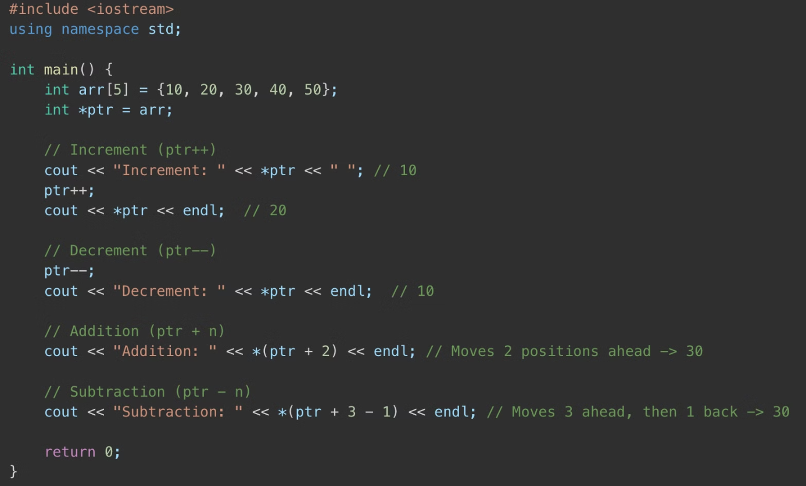
Example for Pointer Arithmetic

Slide 7
Linking with Pointers in Lists
Linked lists are dynamic data structures where elements (nodes) are linked using pointers. Each node contains data and a pointer to the next node. This allows for efficient insertion and deletion of elements, as nodes can be added or removed by simply adjusting the pointers.
Nodes: Each element in a linked list is a node containing data and a pointer.
Pointers: Pointers link each node to the next, forming the list.
Dynamic: Linked lists can grow or shrink as needed during program execution.

Slide 8
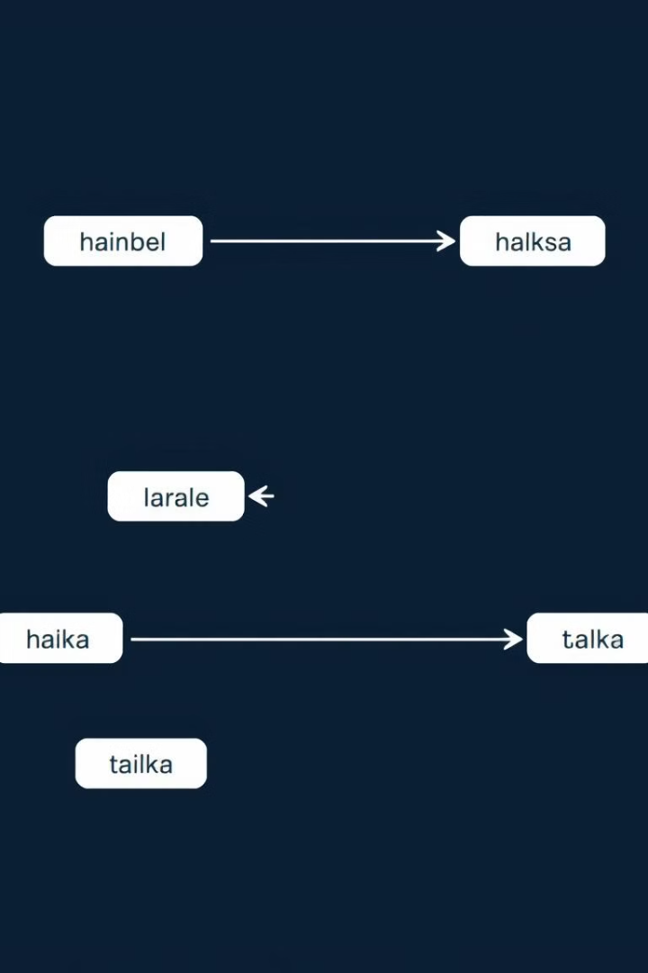
Linking with Pointers in Lists
Nodes
Each node contains data. It also holds a pointer to the next node.
Head Pointer
A pointer to the first node. It marks the beginning of the list.
Traversal
Iterate through the list using pointers. Follow each next pointer.
Dynamic Size
Pointers enable lists to grow. They dynamically allocate memory.

Slide 9
linking of linked lists and usage of pointer

Slide 10

Dynamic Memory Allocation
Dynamic Memory Allocation (DMA) is the process of allocating and deallocating memory at runtime, as opposed to compile-time (static memory allocation). It allows programs to manage memory efficiently by allocating only the required space when needed and freeing it afterward.
1
Flexibility
2
Efficiency
3
Scalability
Allocate memory during program execution, adapting to runtime requirements.
Utilize memory only when needed, and release it promptly when no longer required.
Effectively manage large and complex data structures, expanding memory as necessary.

Slide 11





Memory Functions in C (Static)
malloc
calloc
realloc
free
Allocates a block of memory. Returns a void pointer.
Allocates and clears memory. Initializes it to zero.
Resizes previously allocated memory. Preserves existing data.
Releases allocated memory. Prevents memory leaks.

Slide 12
SMA in C
malloc
calloc
realloc
free
malloc (Memory Allocation) allocates a block of memory of a specified size but does not initialize the memory. If the allocation fails, it returns NULL.
calloc (Contiguous Allocation) allocates memory for an array of elements, and initializes the memory to zero. It is generally used when you need an array or block of memory to be zeroed out.
realloc (Reallocation) changes the size of a previously allocated memory block. It can be used to either expand or shrink the memory.
free is used to deallocate previously allocated memory. After memory is freed, the pointer should be set to NULL to avoid using a "dangling pointer."

Slide 13
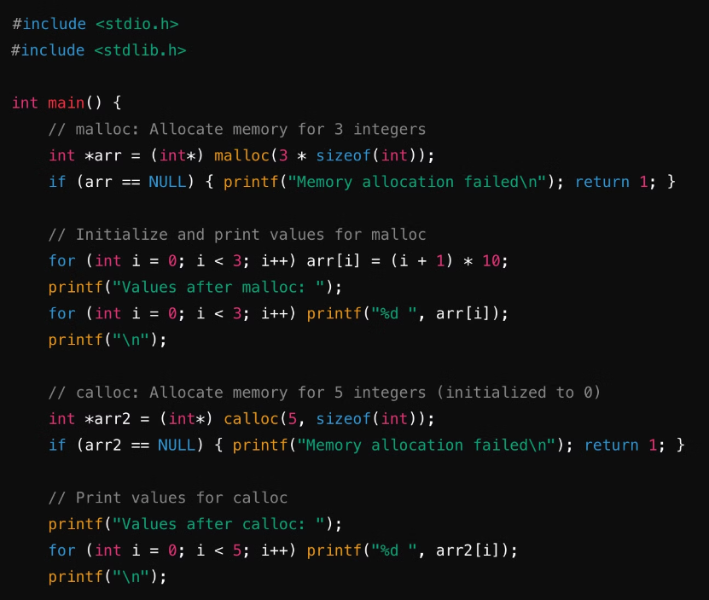
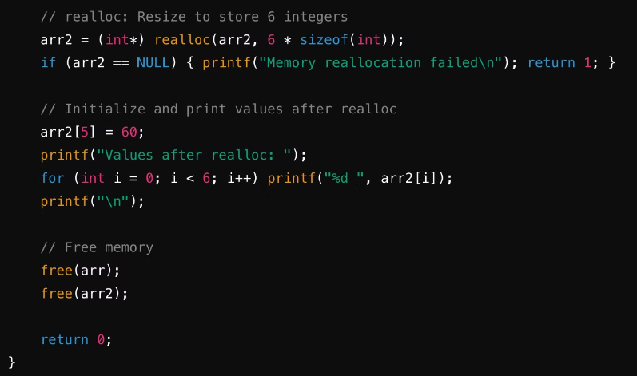
Example for DMA

Slide 14
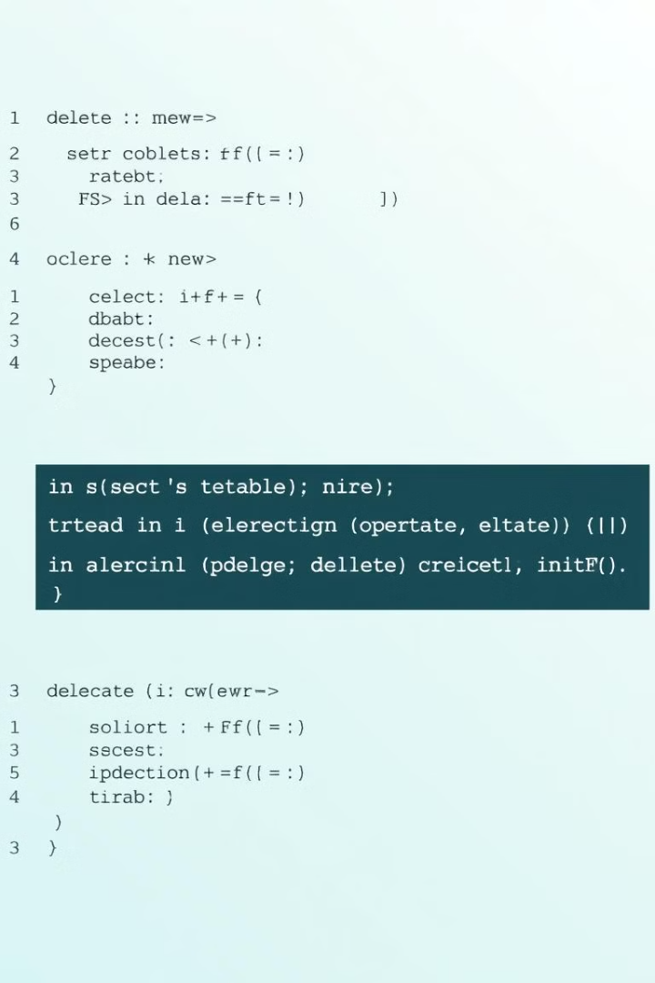
Memory Management in C++ (Dynamic)
1
new
The new operator allocates memory on the heap for a single object or an array of objects. It automatically calls the constructor (if it's a class) and returns a pointer to the allocated memory.
int *ptr = new int;
*ptr = 10;
2
delete
The delete operator frees memory allocated using new. It calls the destructor for class objects and releases the memory back to the heap.
delete ptr;

Slide 15
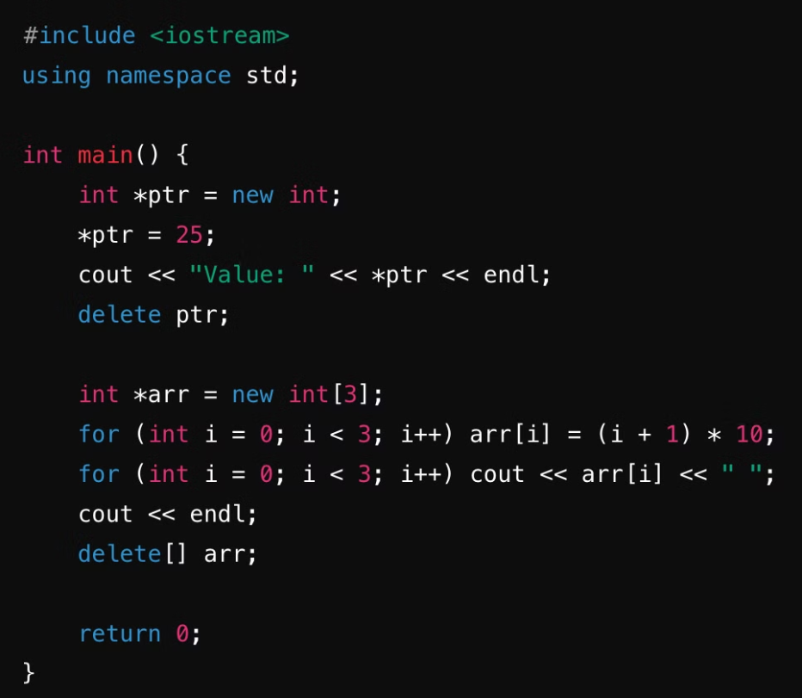
Example for DMA

Slide 16
Structure
Structures in C++ are user-defined data types that group related variables of different data types. They provide a way to create a single entity that can store multiple pieces of information.
Syntax:
struct StructureName {
DataType member1;
DataType member2;
...
};
Declaration Example:
struct Person {
std::string name;
int age;
float salary;
};
Person person1; // Creating a variable of type Person
In this example, a Person structure is defined containing name, age, and salary as members. An instance of Person called person1 is also created.

Slide 17
Key Features of struct in C++
Structures in C++ have several key features that make them useful for grouping related data. Here are some of the most important:
Members: Structures can contain variables of different data types, known as members.
Public Access: By default, members of a structure are public, meaning they can be accessed directly using the dot operator (.).
Methods: Structures can also contain functions, known as methods, which can operate on the structure's data.
Inheritance: Structures can inherit from other structures or classes, allowing for code reuse and the creation of complex data hierarchies.
Constructors and Destructors: Structures can have constructors, which are special methods that initialize the structure's members when it is created, and destructors, which are special methods that clean up resources when the structure is destroyed.

Slide 18
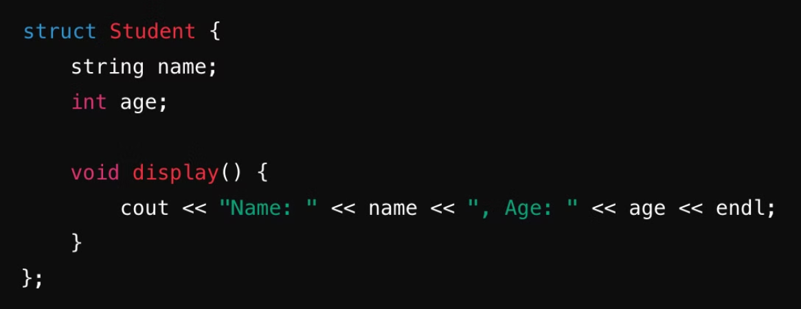
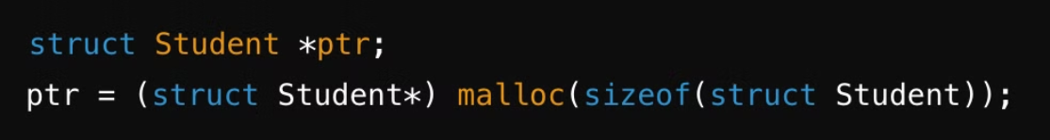
Example of Structures in C++
Structures with Pointers

Slide 19
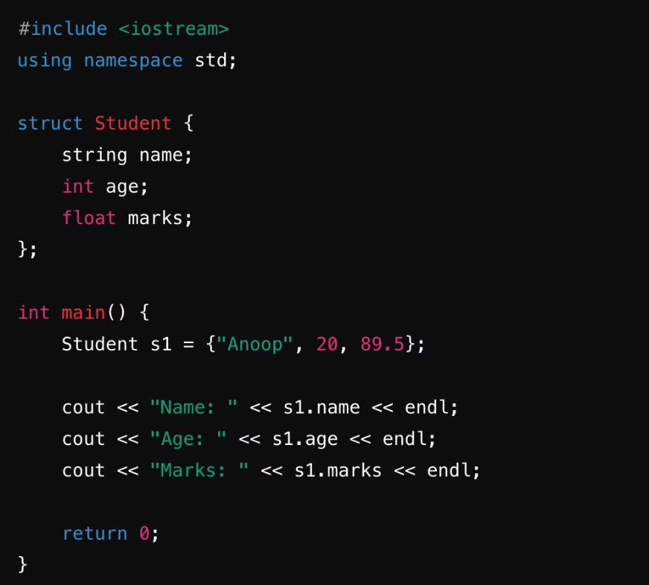
Example of struct

Slide 20
Structures Enhanced with Pointers
1
Dynamic Data Structures
2
Efficient Memory Use
3
Complex Relationships
Pointers let structures create dynamic data structures. Linked lists and trees use these structures.
Pointers help manage memory. They allocate only what is needed, saving space.
Pointers link structures. This makes complex data relationships possible.
Feature
Example
Pointer to Structure
Student *ptr = &s1;
Access Members with Pointer
ptr->name (or (*ptr).name)
Dynamic Structure Allocation
Student *ptr = new Student;
Freeing Memory
delete ptr;
Array of Structures with Pointer
Student *ptr = students;

Slide 21
Structures Enhanced with Pointers
Dynamic Structures
Linked Structures
Create structures at runtime. Pointers enable dynamic creation, allowing for flexible memory allocation and management. This is especially useful when the size of the data structure is not known at compile time.
Structures can point to each other, enabling the construction of linked data structures like linked lists, trees, and graphs. This allows for efficient insertion, deletion, and traversal of elements.
Example:
Example:
struct Node { int data; Node* next; }; Node* newNode = new Node;
struct Node { int data; Node* next; }; Node* head = nullptr;
// Pointer to the first node

Slide 22
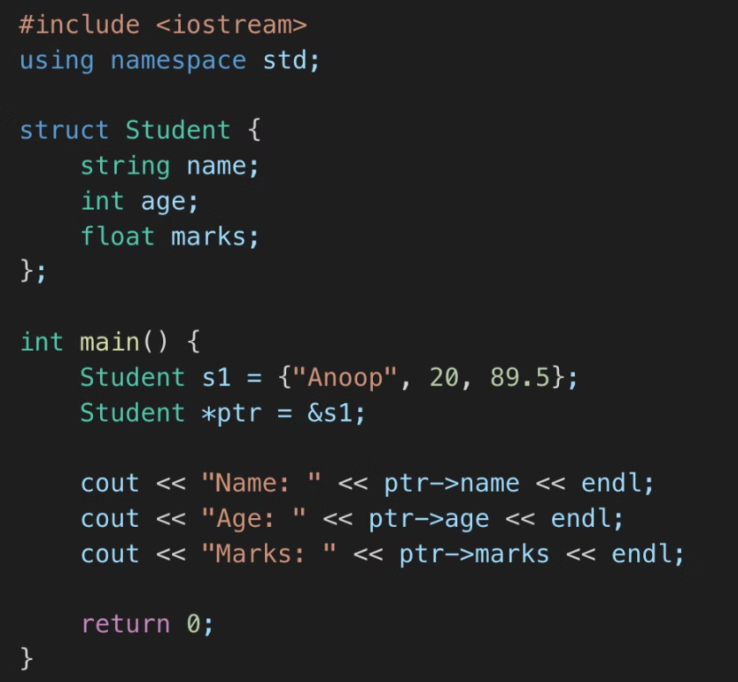
ptr->name is equivalent to (*ptr).name.

